Slide 1

Bangladesh University of Business And Technology (BUBT) Parbon
-And it’s done

Slide 2
Supervised By | Presented By (Group members Details)
Dipu Akter Shila Teaching Assistant Dept. Of. CSE BUBT | Ahmed Mahir Shoaib ID: 18192103235 Abu Zobayer Bin Siddique ID: 18192103226 All Moon Tasir ID: 18192103256

Slide 3
Parbon
We basically get all the services around through the app. So we thought that if we can bring the catering service in the app, then the hassle of organizing any event for everyone will be reduced and the facilities will be easily available. So we have chosen this project.

Slide 4
Parbon (Catering Service based App)
User Details
Send Confirmation Email when create any account
Online Food Order
Online Catering Service
User’s Booking Information
Seller’s Order Information
Online Decorator Service
Rent Community Center By online

Slide 5
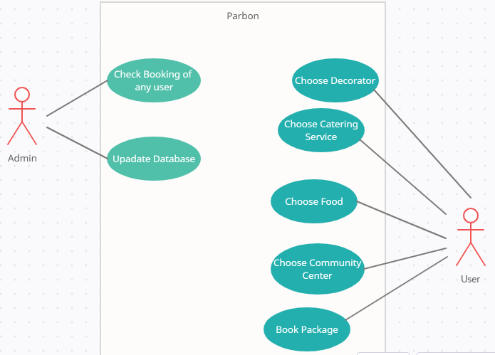
Case Diagram of This Project

Slide 6
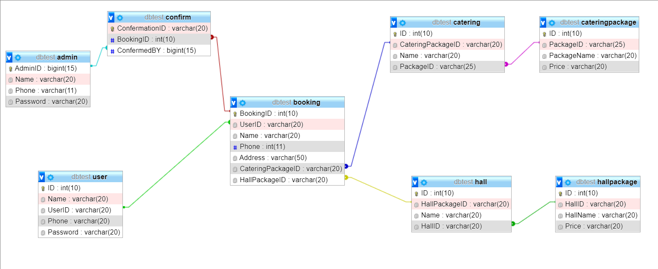
ER Diagram

Slide 7
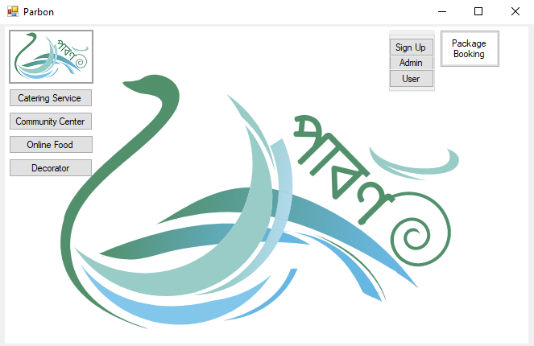
Home Page

Slide 8

Catering Service

Slide 9
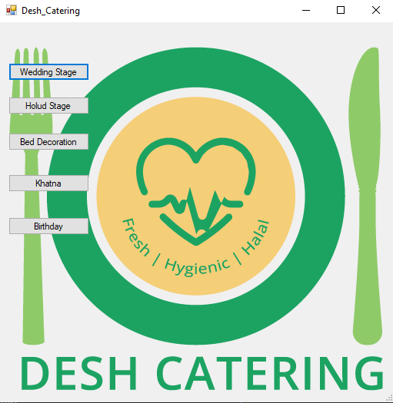
Desh Catering (Details of Catering)

Slide 10
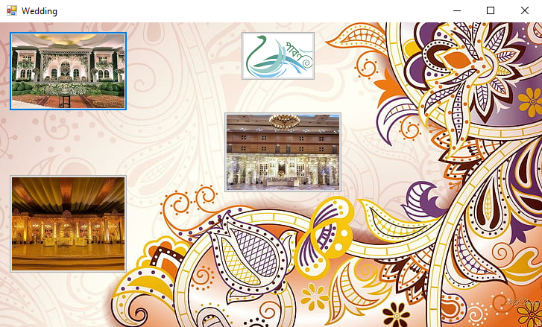
Wedding Stage

Slide 11
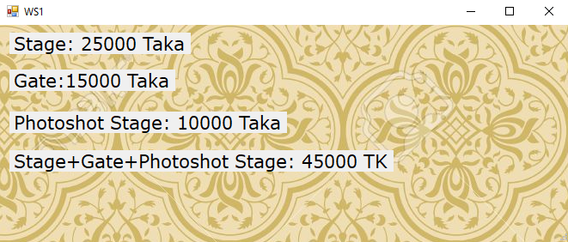
Wedding Stage Details

Slide 12
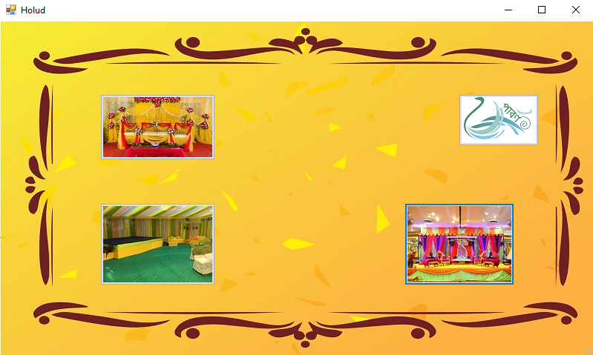
Holud Stage

Slide 13
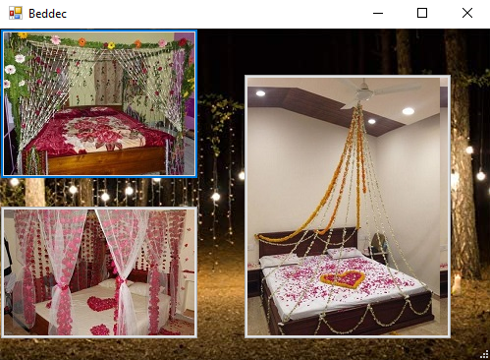
Bed Decoration

Slide 14
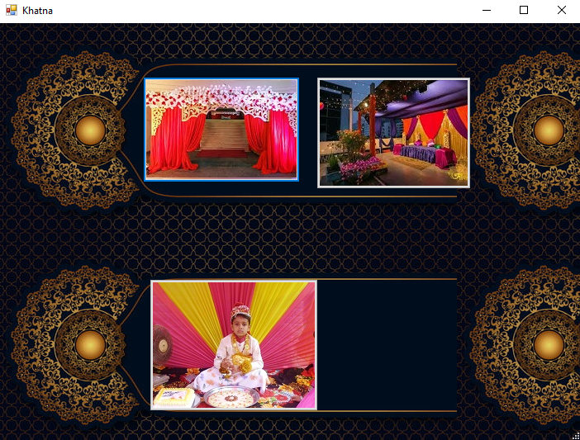
Khatna

Slide 15
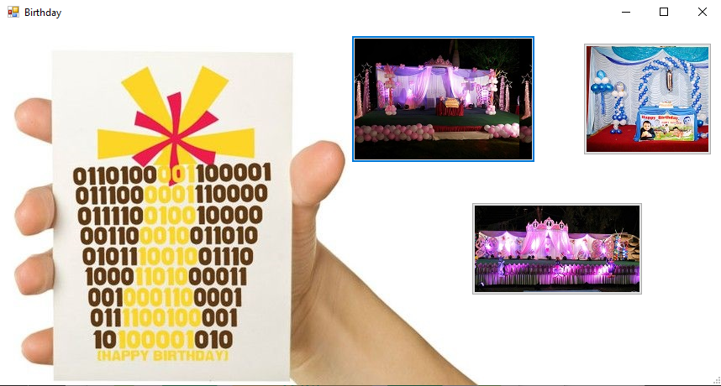
Birthday Plan

Slide 16
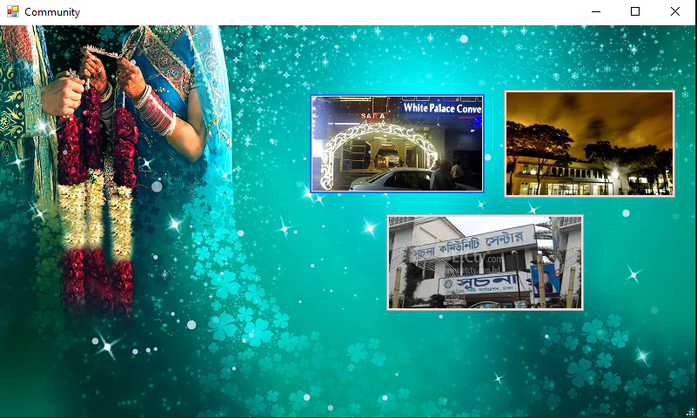
Community Center

Slide 17
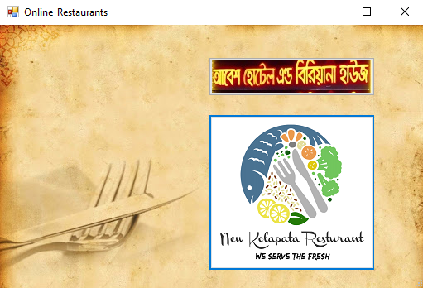
Online Food

Slide 18
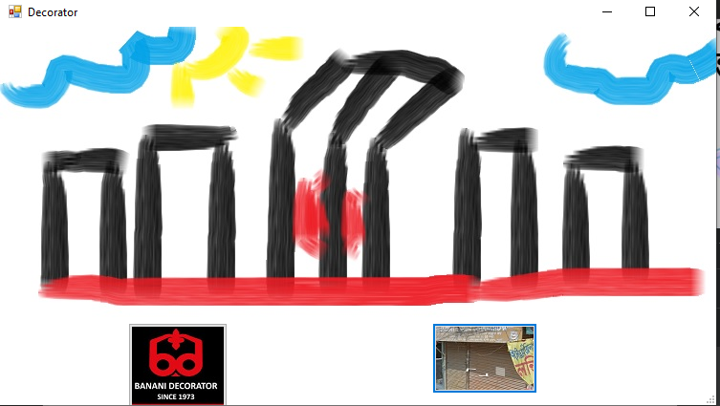
Decorator

Slide 19
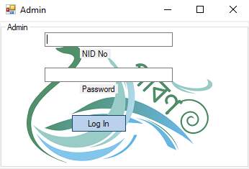
Admin Login

Slide 20
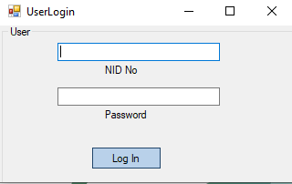
User Log In

Slide 21
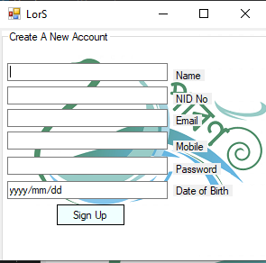
User Registration

Slide 22
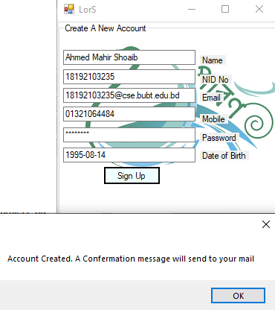
Account Create Message

Slide 23
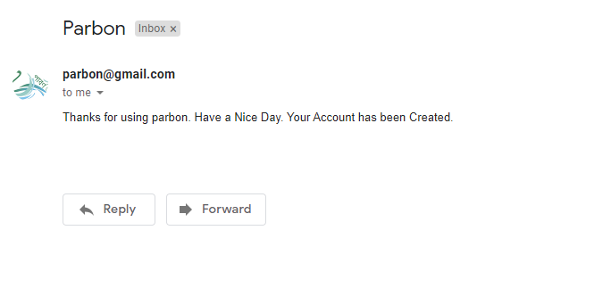
Confirmation Mail

Slide 24
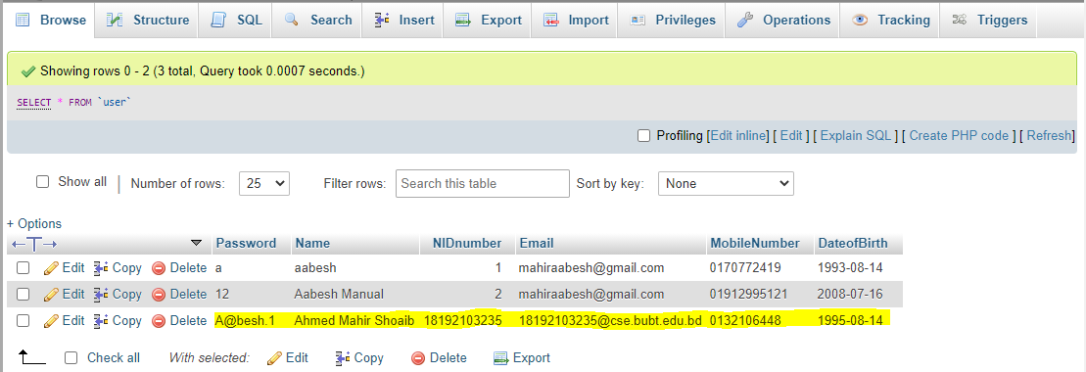
User Info In Database

Slide 25
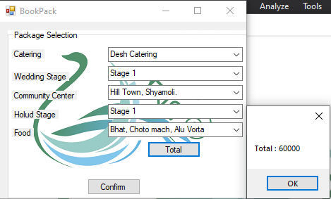
Package Booking

Slide 26
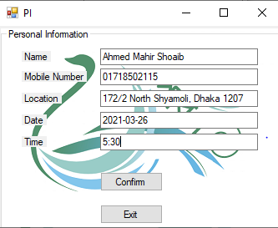
Final Confirmation from user and Getting his info for booking

Slide 27
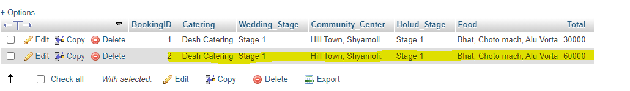
Package Saved In Database

Slide 28
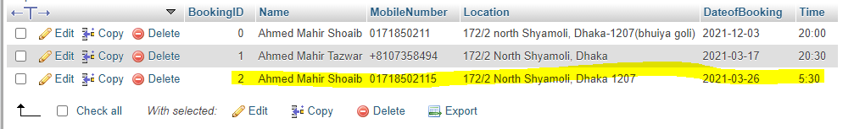
Information Saved In Database

Slide 29


